Slide 1
Github: Repositories & Portfolio Websites
James R. Bradley

Slide 2
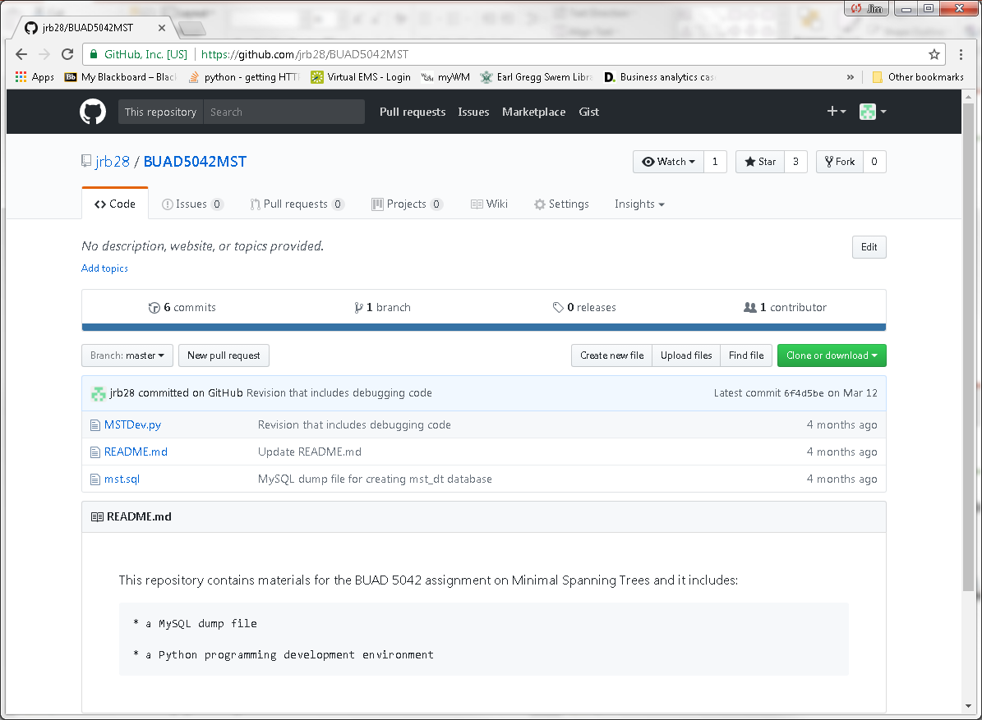
Github
You may well have been to github.com
Place for storing/distributing files: repository (repo)
Git is integrated with Github site
Git provides for version control

Slide 3
Github
Github can be important for another reason
Publish a portfolio of work for use in your job search

Slide 4
Github Repositories (Repos)

Slide 5


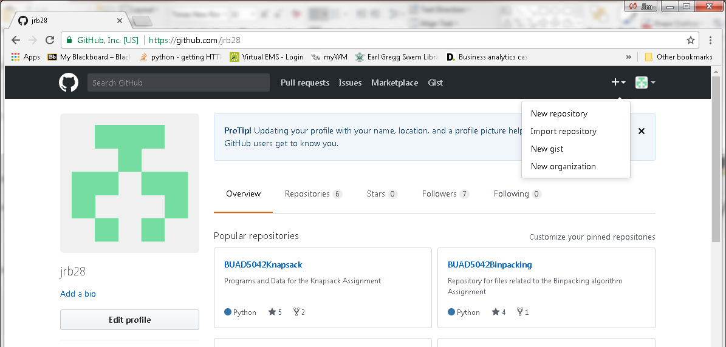
Github Repositories
Create account: go to https://github.com/
Create a repository

Slide 6
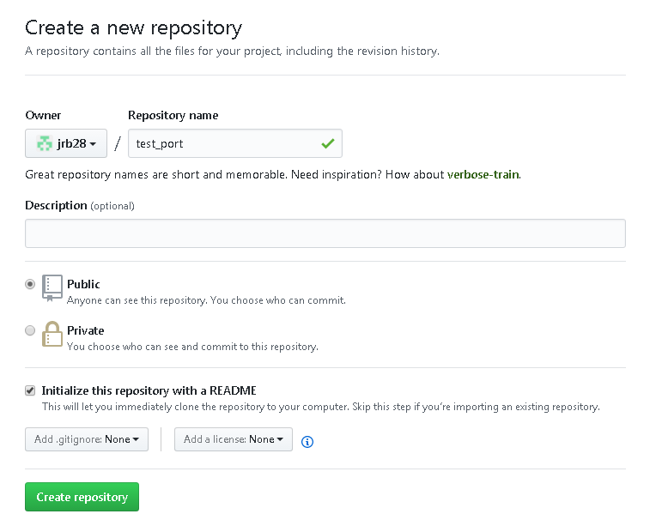
Github Repositories
Choose Public repository (free)
Choose Initialize this repository with a README

Slide 7
Github Repositories
Click on Upload Files button
Select files or drag to browser
Change commit message if desired
Click on Commit Changes button

Slide 8
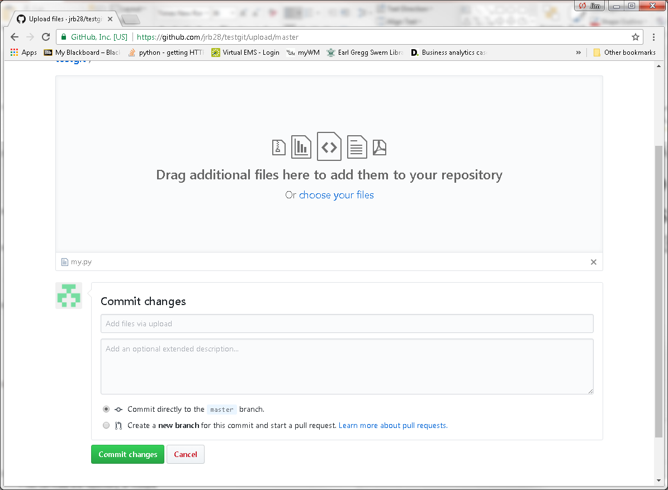
Github Repositories

Slide 9
Portfolio in Github Repository
Good artifacts of your experience in a Github repo:
Code, Jupyter notebooks, presentations, reports, etc.
Use multiple repos
Focus each on different topics, job searches
Organize your files within folders for neatness
Jupyter notebooks in repos are rendered as html web pages
Opportunity to show your work and explain what you did

Slide 10
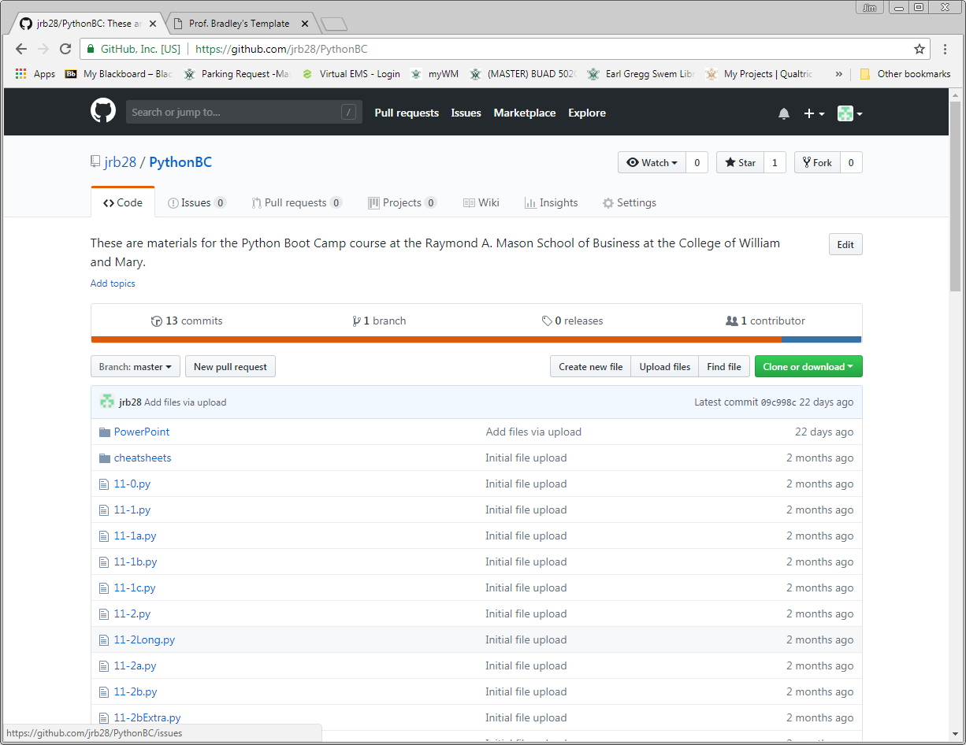
Portfolio in Github Repository
Example Github repo

Slide 11
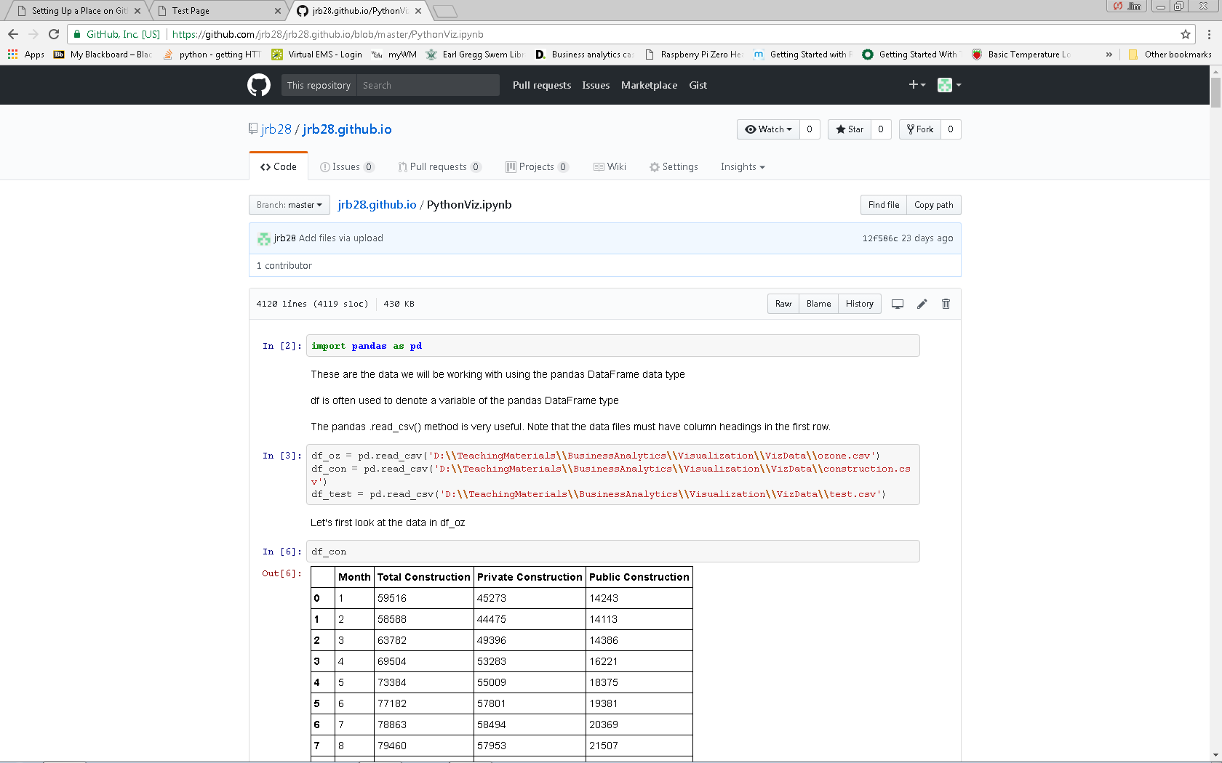
Portfolio Website on Github
Jupyter notebook example

Slide 12
Github Portfolio Web Sites

Slide 13
Portfolio Website on Github
Github.com also allows a web page
Create a GitHub repository with this name:
username.github.io
Browse to your web page
username.github.io
Edit your site:
github.com/username/username.github.io
View your site:
username.github.io

Slide 14
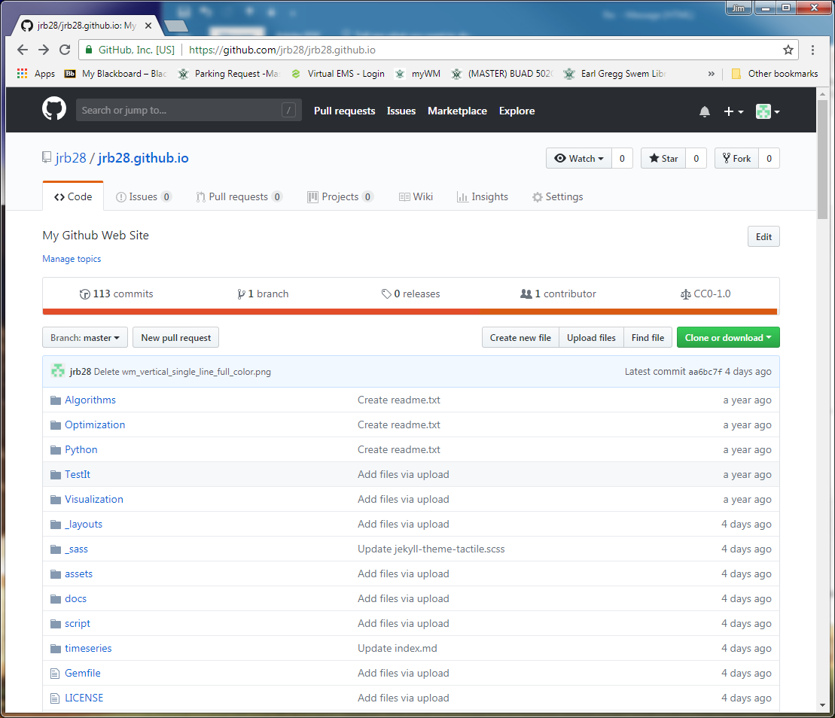
Portfolio Website on Github
Manage website
Add files just like other repositories
Uploading content by dragging files from File Explorer to Github folder
Commit changes

Slide 15
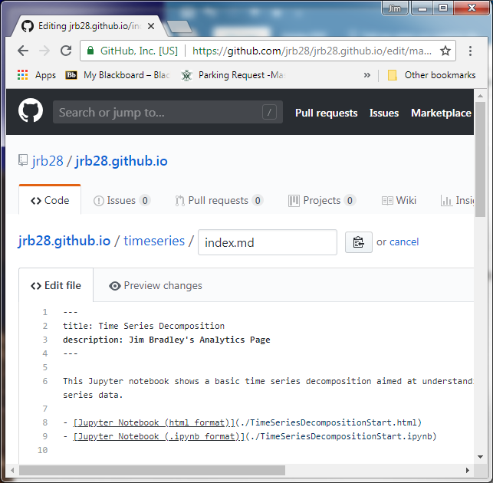
Portfolio Website on Github
Create web pages using markdown
Choose theme
Download zip file
Edit index.md using text editor
A markdown file
Upload all files & folders
Tips
Each page should have a title and description between the set of three dashes
Edit .scss file in _sass folder for format revisions

Slide 16
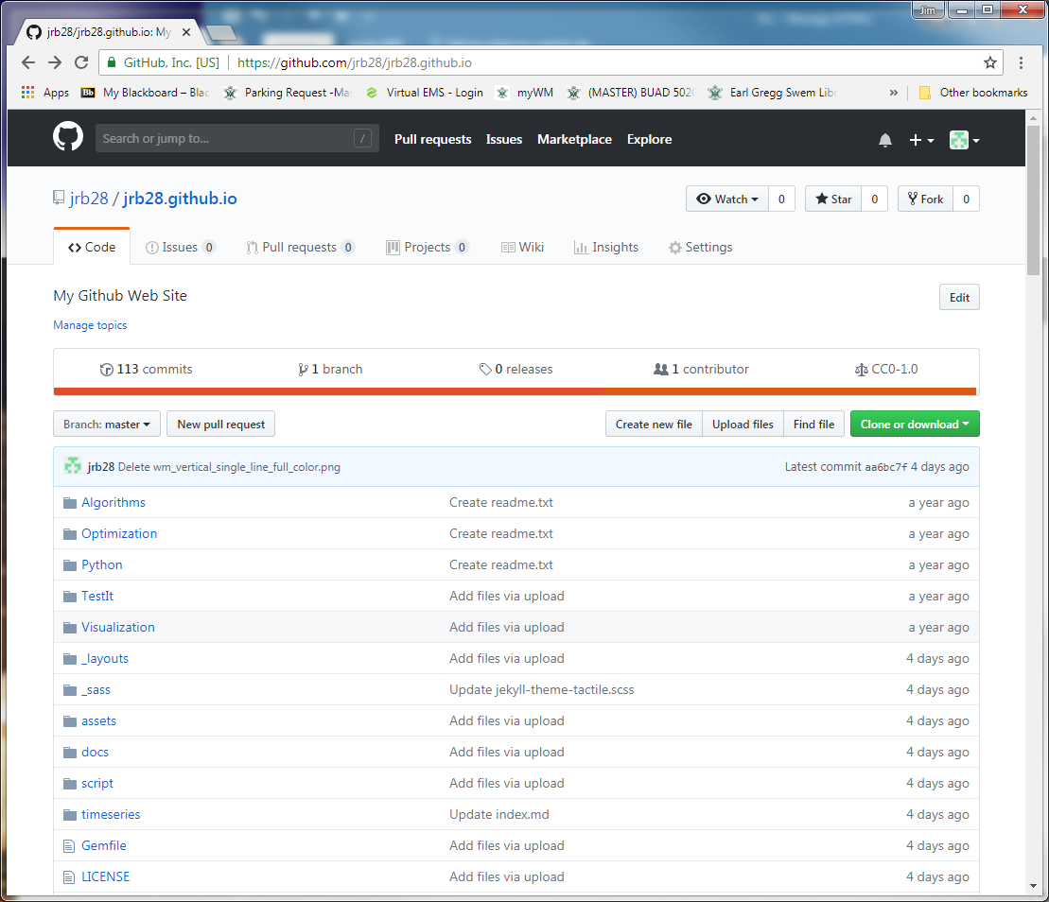
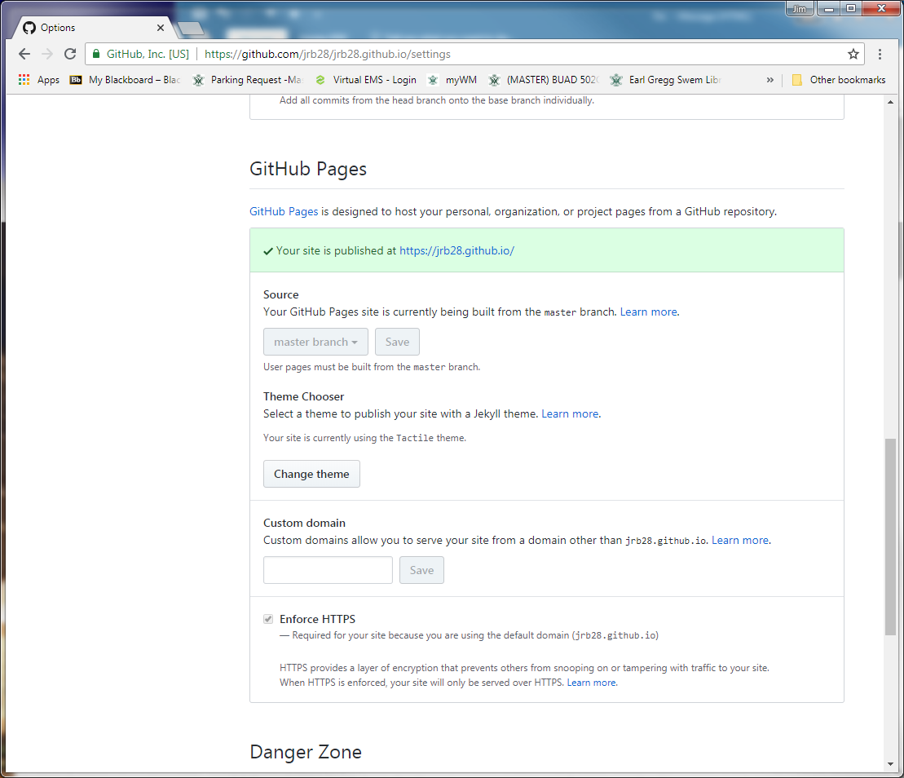
Portfolio Website on Github

Slide 17
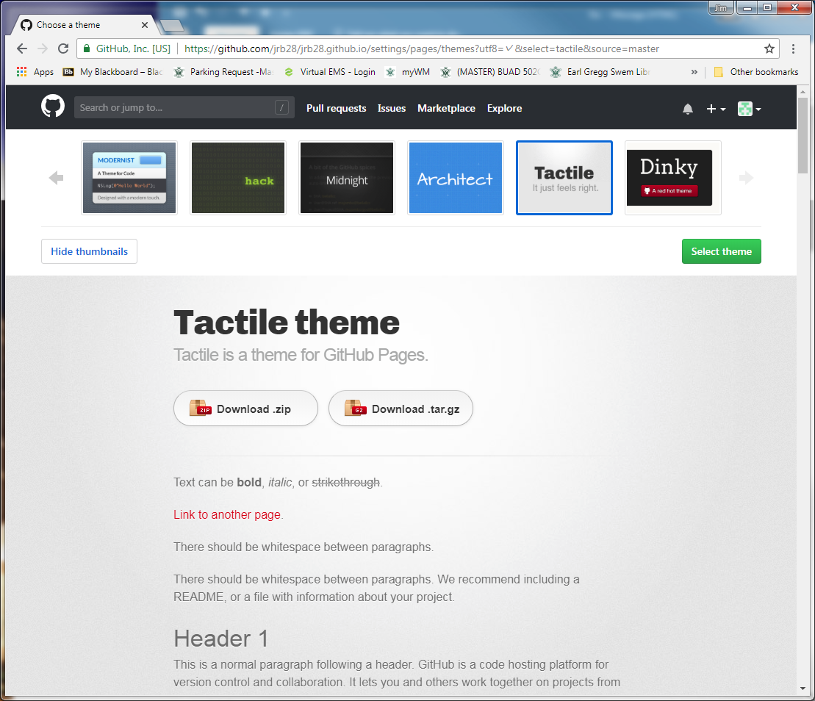
Portfolio Website on Github

Slide 18
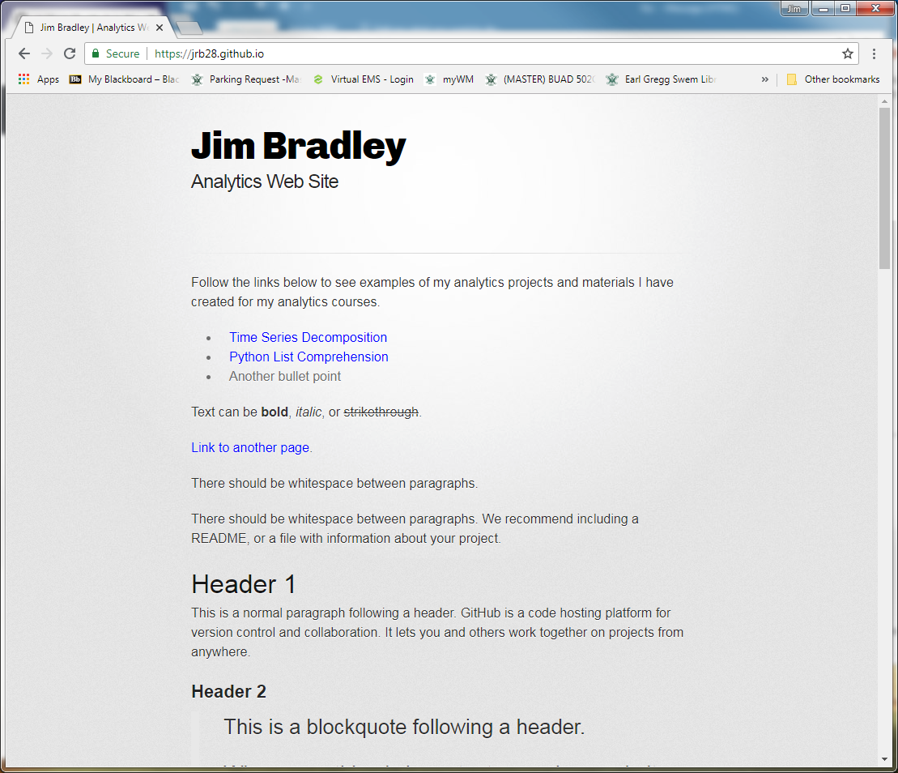
Portfolio Website on Github
View website

Slide 19
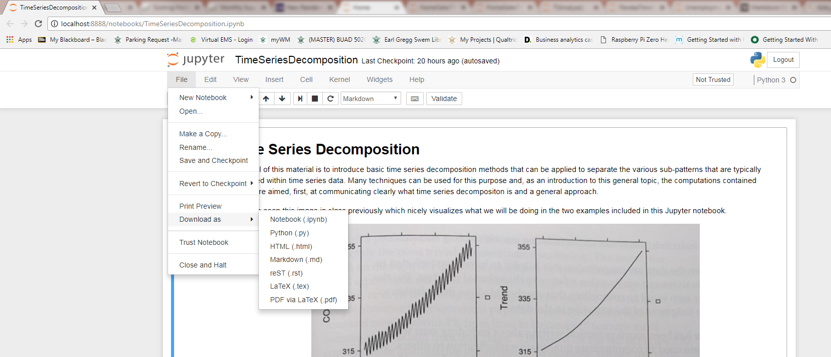
Portfolio Website on Github
How to convert Jupyter notebooks to html

Slide 20
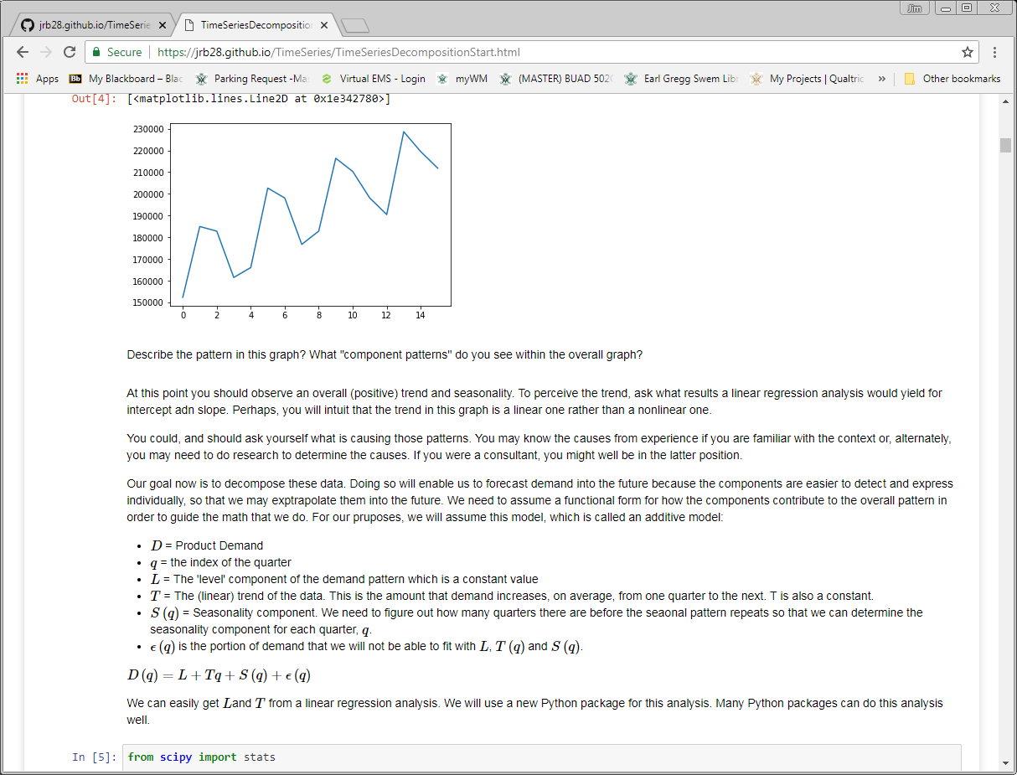
Portfolio Website on Github
Jupyter from a Github web page
Notice URL indicates .html file

Slide 21
Portfolio Website on Github
One HTML editing option
Microsoft Web Expressions (free download)
https://www.microsoft.com/en-us/download/details.aspx?id=36179
HTML code reference
www.w3schools.com/html/

Slide 22
Portfolio Website on Github
Resources & Ideas
https://dannguyen.github.io/github-for-portfolios/
See first tutorial for basics of setting up a Github web page
http://blog.udacity.com/2016/02/how-to-build-a-data-analysis-portfolio-that-will-get-you-hired.html
https://techbeacon.com/what-do-job-seeking-developers-need-their-github
https://help.github.com/articles/working-with-jupyter-notebook-files-on-github/
Jupyter and Github
https://www.dataquest.io/blog/how-to-share-data-science-portfolio/

